Slide 1
Waste Impact Calculator:
Context and Concepts
Notes:
Hi, I’m Martin Brown from the Oregon Dept. of Environmental Quality, and in this presentation I’m going to give some background for the Waste Impact Calculator model. You’ll have a much better idea of both the value and the limitations of the model if you absorb this background material before you start pushing buttons!

Slide 2
What is solid waste?
Notes:
The Waste Impact Calculator is about the environmental effects of solid waste. So we should define what that term “solid waste” means.

Slide 3
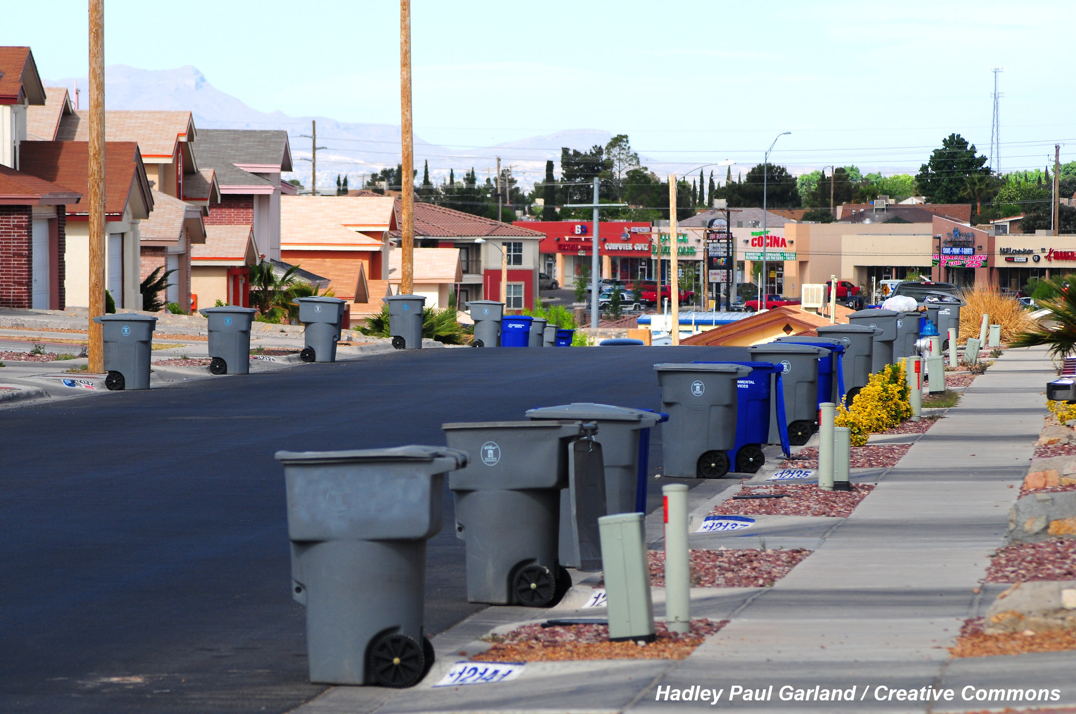
Notes:
Let’s start with an intuitive definition.
Here’s a picture of a municipal trash collection. Notice how the cans of trash and recycling are all clearly separated from the houses? Waste can be defined as the stuff that people get rid of!
That’s the viewpoint of historian Susan Strasser, in her book Waste and Want. Strasser emphasizes the act of separating things into categories based on value.
For example, most people don’t put gold jewelry or working appliances out on the street for collection, because they value those things, either in an economic way or otherwise.
But materials like used newspapers and pop cans are different. They have little enough value to most people that they would rather be rid of them. There might be some cash value to those things, but it’s too low for most people to go try to obtain it for themselves.
This perspective is useful to keep in mind when you’re thinking about the economic logic of recycling. Sometimes, one person’s trash is another person’s treasure. But sometimes, one person’s trash is just trash.

Slide 4
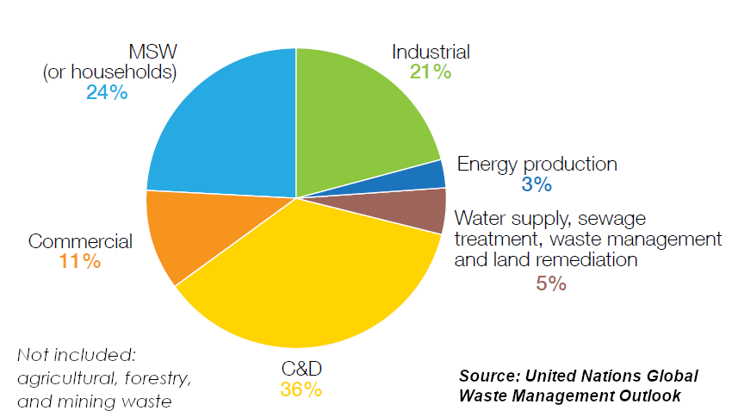
✓
?
?
✓
?
x
?
Notes:
More legalistic definitions of solid waste can be found in statistics from governments and nonprofits. Here’s a chart from the UN that attempts to break down all the different parties or activities that might have stuff to get rid of – that is, who might produce solid waste.
There are commercial operations, like stores, and households. Government statistics usually do include those in what they call solid waste, so I’ll put check marks by those operations.
But all sorts of other operations also have to get rid of stuff. Such as industrial operations, energy production facilities, water treatment plants, and construction sites. Governments differ greatly in whether they include these things in what they call solid waste.
And nobody includes the huge amounts of waste that are generated in agricultural, forestry, and mining operations.

Slide 5
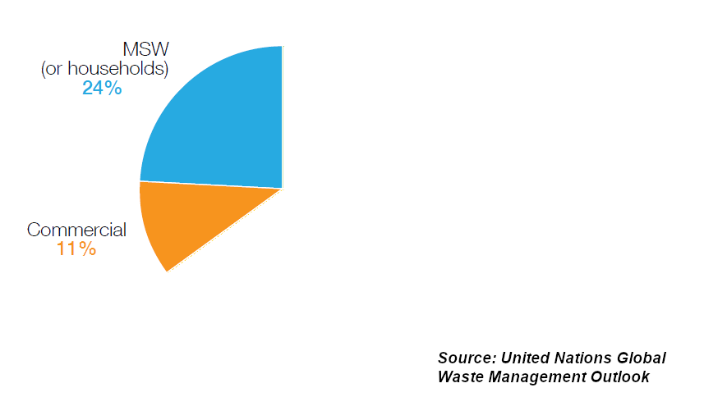
Notes:
That means when you hear the term solid waste, you are usually just hearing about municipal and commercial waste. That’s how the term is used in the Waste Impact Calculator, because that’s how Oregon defines it in its state environmental law.

Slide 6
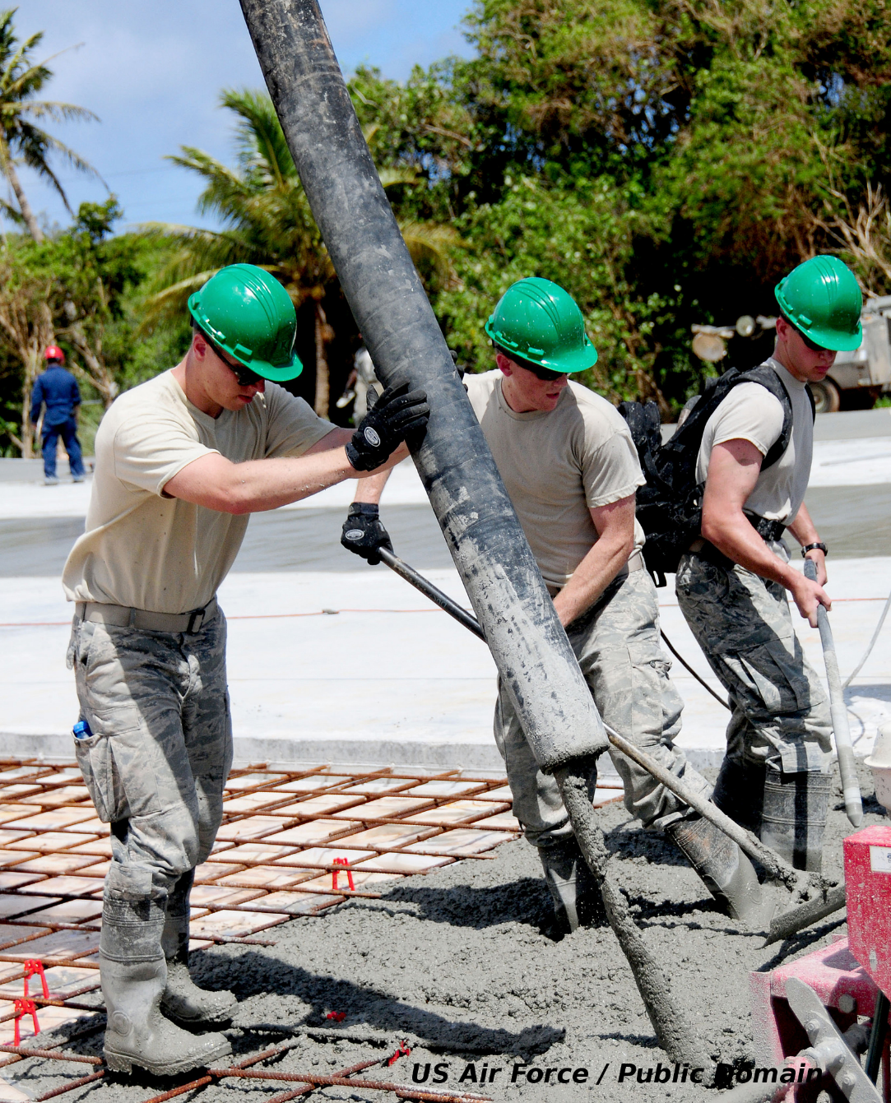
Notes:
As you get more and more into the environmental effects of solid waste, it’s important to remember that there are lots of materials which have a big impact on the environment that solid waste statistics will never tell you about.
Concrete is one example. It’s responsible for a large portion of greenhouse gas emissions planet wide, but the concrete they pour today won’t be in the solid waste stream – if it’s even counted – for a hundred years.
So solid waste is surely related to affluence and consumption, but solid waste doesn’t tell the whole story about how materials and products influence the environment.

Slide 7
How is solid waste a problem?
And how is the problem measured?
Notes:
Solid waste is usually presented as a source of problems. Let’s get specific about how solid waste can, or just might, be a bad thing and how that tends to be measured.

Slide 8
The traditional view: direct effects of waste and litter
Notes:
The traditional way of describing the problem of solid waste has been to describe the direct physical effects it does, or could, have.

Slide 9
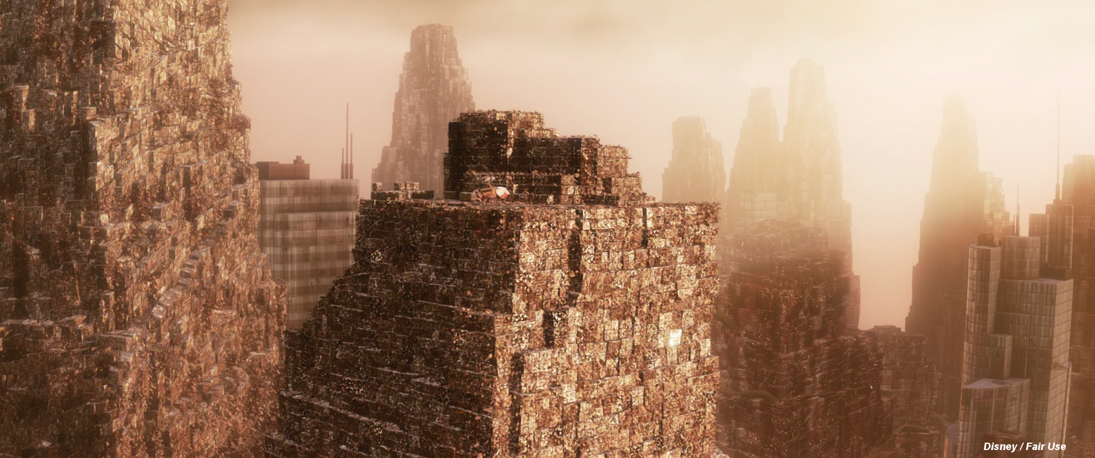
Notes:
First, there used to be a concern that the country or the world was literally running out of room to put waste. You’ve probably seen this amazing scene in WALL-E where our hero builds a ziggurat out of compacted trash.
It certainly is poetic, but as a practical matter this is not true in the American West. Disposing of stuff might not be a good idea, but if we want to, there’s lots of room to do it.

Slide 10
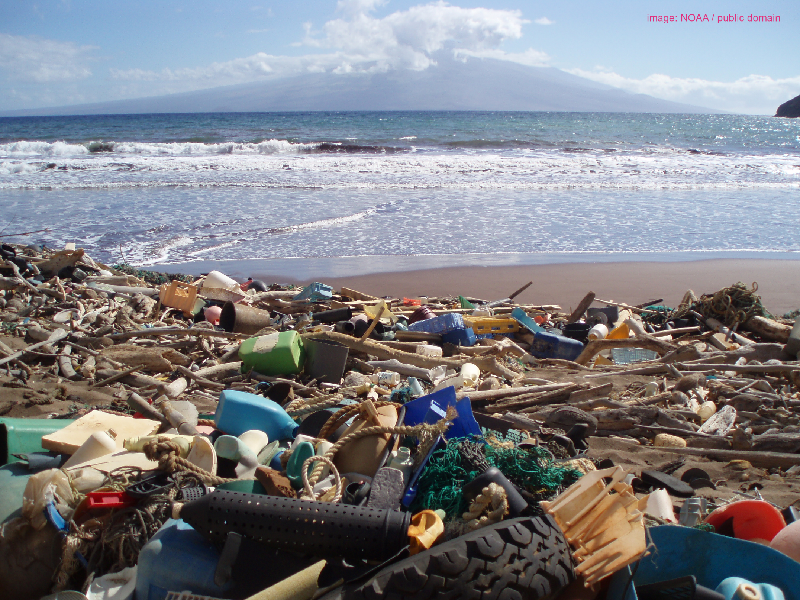
Notes:
More recently, concern has been about the effects of litter in the environment, like this plastic trash on a Hawaiian beach. Trash like this stays around in the environment and definitely affects wildlife, as we’ve seen in a bunch of heartbreaking pictures.

Slide 11
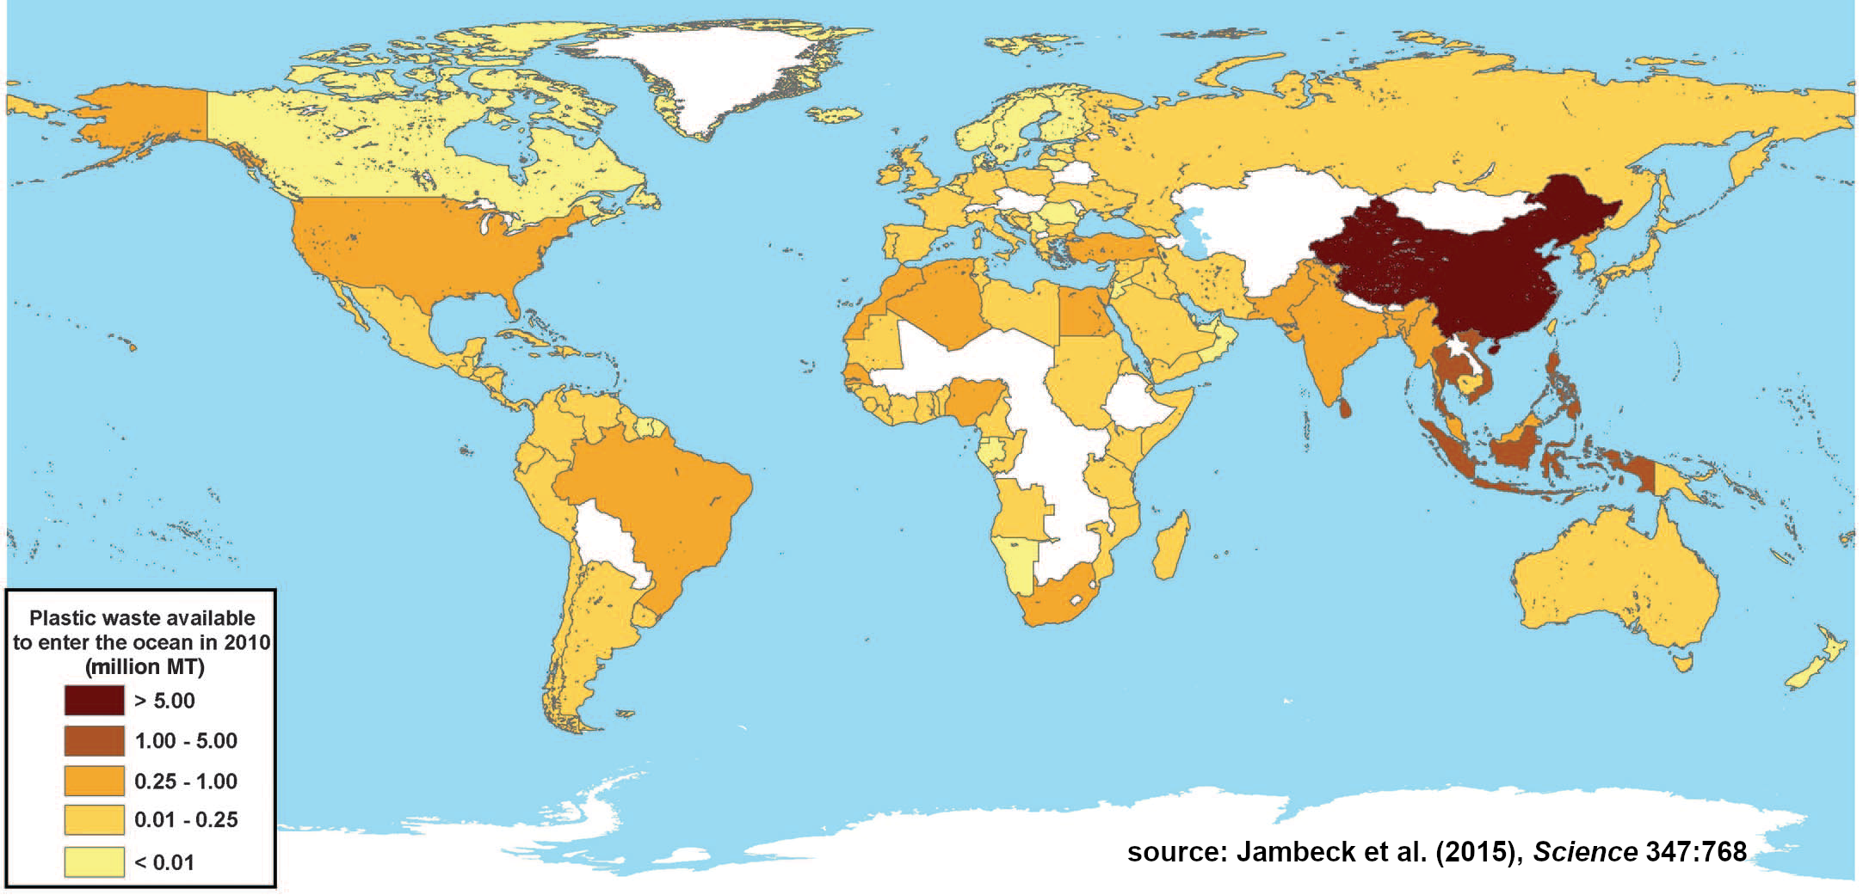
Notes:
However, by and large the United States is not a big source of such marine plastics. Here’s a map from a review in 2015 which reviewed the sources of plastic going in to the oceans, and it really suggests most of them are coming from Asia, where there are not developed solid waste systems.
That’s why improving waste collection and management systems is a big priority for the UN. But in the United States, we are in relatively good shape to pick up trash.

Slide 12
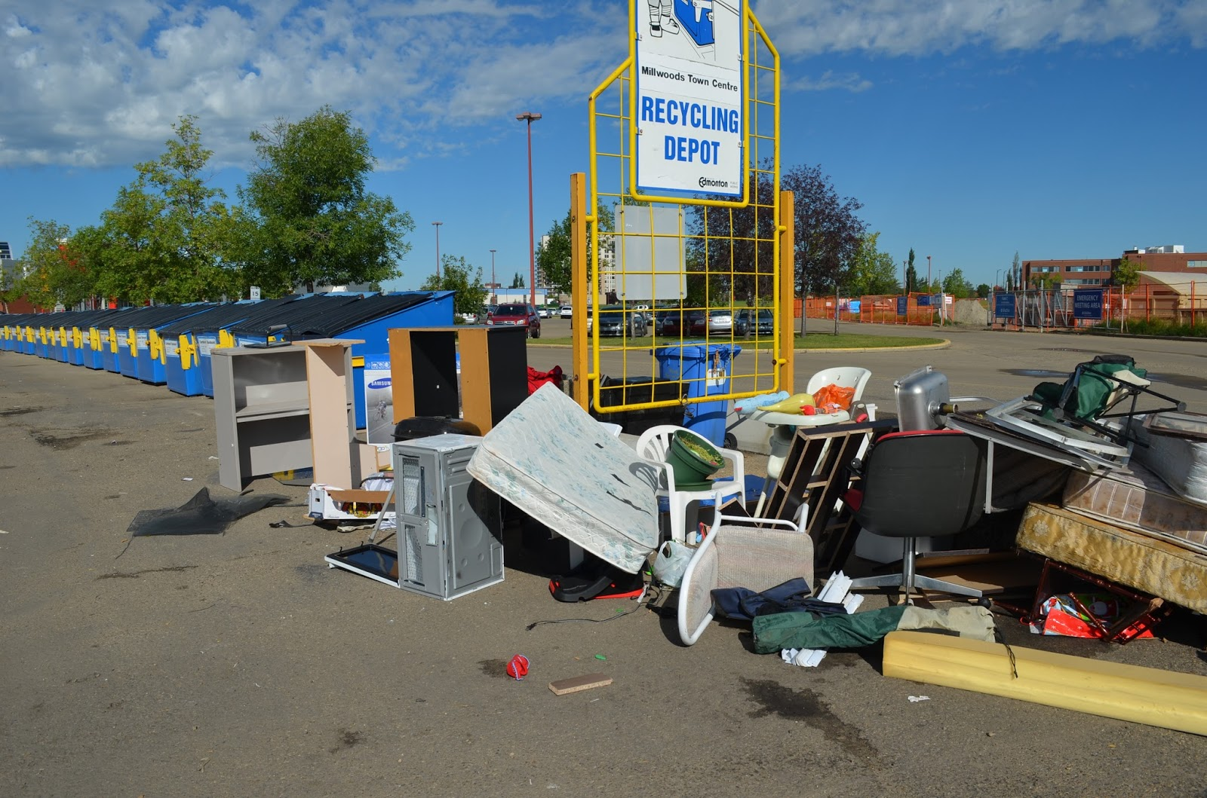
fortheloveofwaste.blogspot.com / fair use
Notes:
Finally, trash gives many people a sense that something is being wasted. Here’s a picture of a recycling depot where there has been some wishful placement of material. People want their stuff to be recycled or reused, even when they don’t want it themselves anymore. Waste is seen as a resource.

Slide 13
Themes of the traditional view
Waste can cause problems directly – like litter
However, waste is still a resource and the value it has should be preserved
Landfilling is bad
Recycling is good
The goal of management is to prevent landfilling.
Notes:
To sum up, the traditional view of the “problem” of solid waste is that – even though waste is kind of a bad thing – it is also a resource that we are throwing away. Because it’s a resource, landfilling it is bad, and recycling it is good.

Slide 14
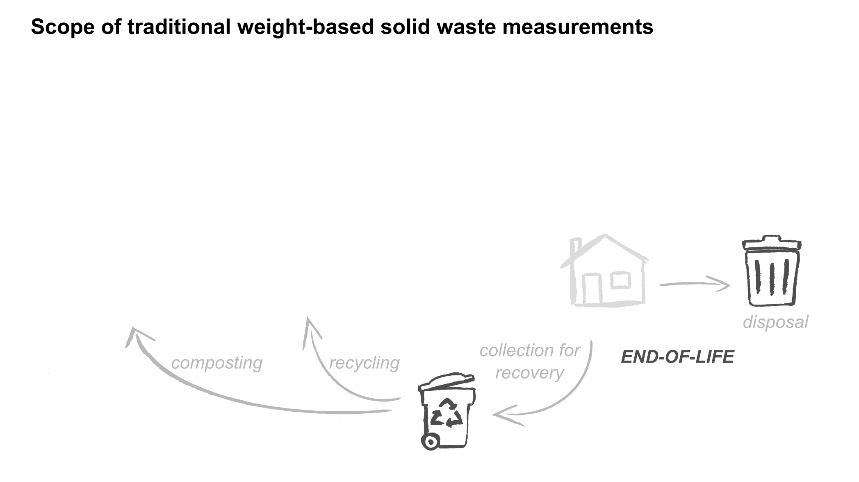
Traditional waste statistics express those themes with weights
Generation = total weight (tons)
Recycling Rate = recycling weight / total weight (%)
Notes:
The traditional ways of quantifying solid waste have reflected these themes, in particular expressing them in terms of weight.
The total amount of stuff leaving households and businesses, whether to be disposed or recycled, is called waste generation, and it’s in tons.
The percentage of that amount that you happen to recycle is the recycling rate. In Oregon we call that the recovery rate because it also includes composting.

Slide 15
But…. something is clearly missing from this chart
Everything that is waste comes from somewhere
Notes:
But when you look at that diagram, it’s easy to see that something is missing.
Waste isn’t actually generated by households and businesses. The stuff that becomes waste had to come from somewhere….

Slide 16
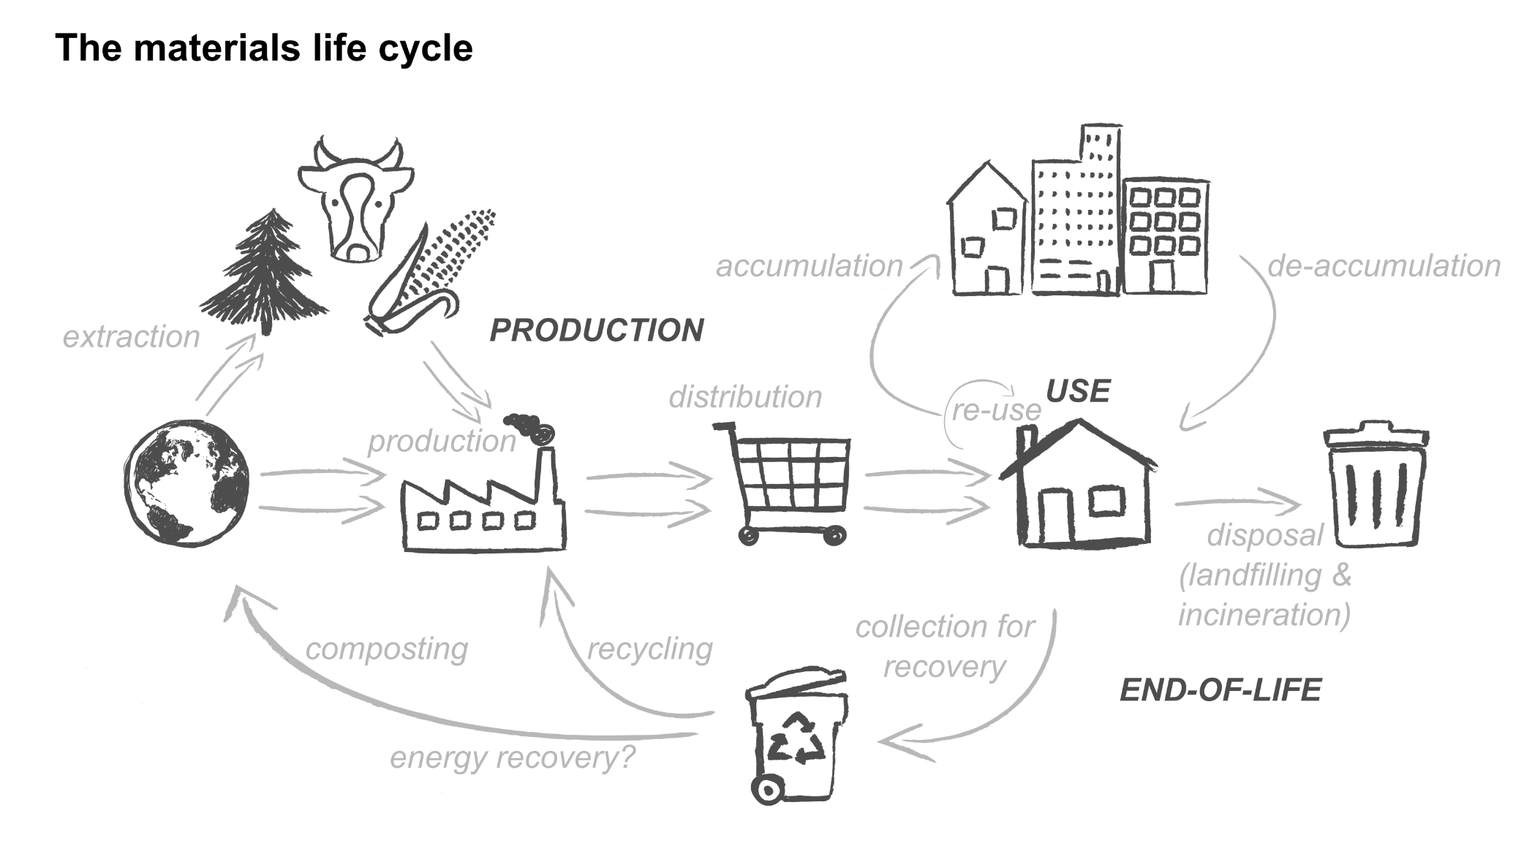
The materials life cycle
Notes:
And we call that fact the materials life cycle.
Everything that becomes waste started out by being extracted from the earth somehow. Then it was packaged or refined, made into products. Then it was distributed and used. Finally it was disposed or recycled.
But the point is there is a lot activity along the way. At every step fuel was burned, water was used, a bit of pollution was generated, and so on.

Slide 17
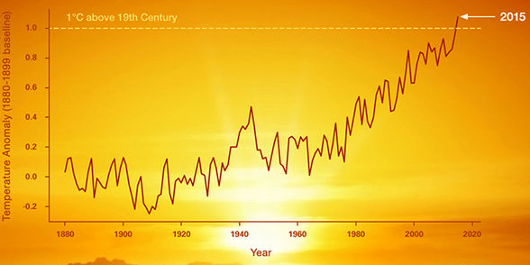
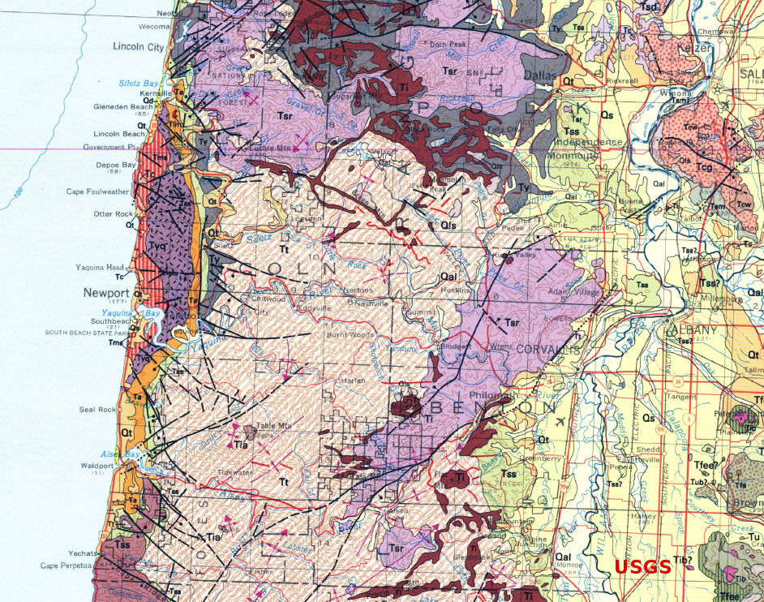
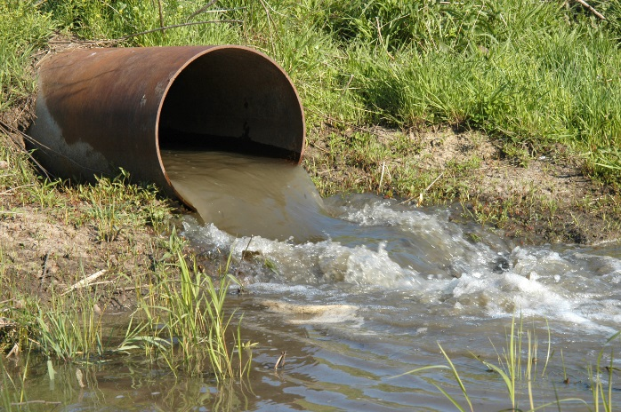
Environmental impacts happen at every step
Notes:
These are “environmental impacts” GHG emissions, water pollution, and land use change. The material in waste is linked to all those changes – not just whatever might happen in the landfill or recycling system.

Slide 18
A new view: waste as a source of impacts
Notes:
So the new view of the “problem” of solid waste is that waste is a source of life cycle impacts.

Slide 19
Measurements should report the total impacts of the stuff that becomes waste
Notes:
This new view says that the effect of solid waste should be measured by the total impact linked to that waste over the whole materials life cycle.
The goal of management is to reduce that total impact.

Slide 20
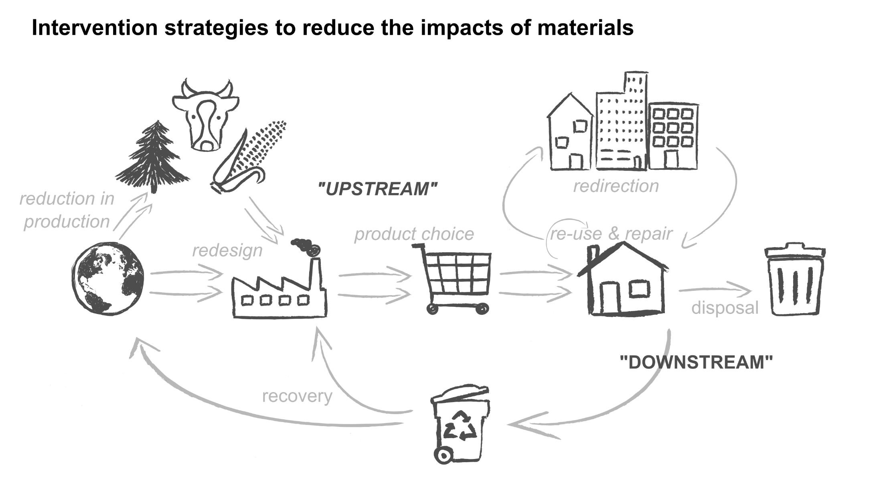
The goal of management is to minimize impacts – by any means
Notes:
There are lots of ways to reduce impacts. Products can be redesigned. They can be made to last longer. They can be produced in a different way. And yes, they can be recycled, but that’s just one way of many.

Slide 21
Themes of the life cycle impact view
Waste represents materials that have caused impacts over the course of their life cycles
The goal is to reduce the total impacts of the materials that become waste
There are many ways to do this
Because of this broader view, “waste management” might be reconceived as “materials management”

Slide 22
WIC bridges the gap

Slide 23
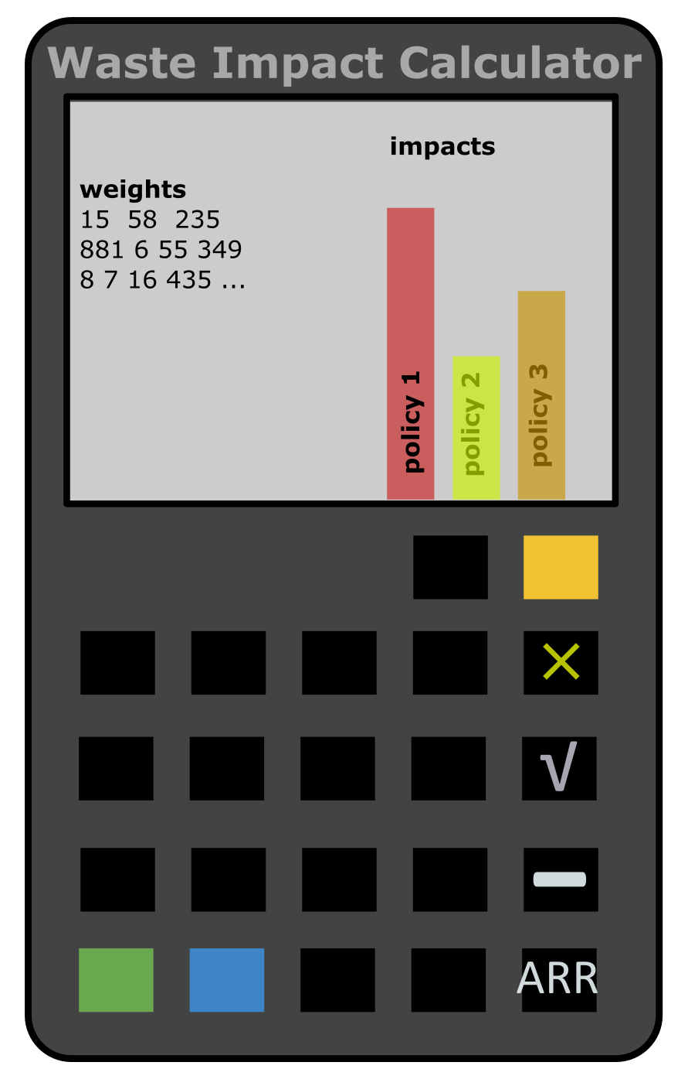
Notes:
It is a calculator. WIC takes what you know about solid waste – how many tons of stuff are going to what sorts of places – and figures the life cycle environmental impacts for that stuff. It also lets you imagine you are handling waste in different ways…. And see how the impacts change.

Slide 24
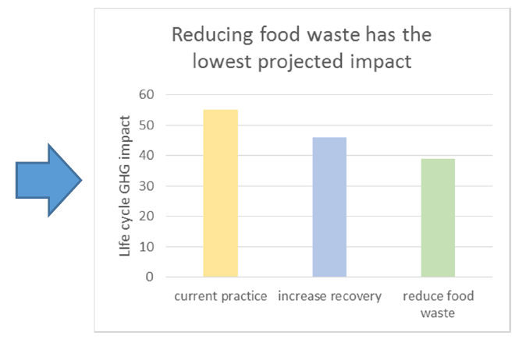
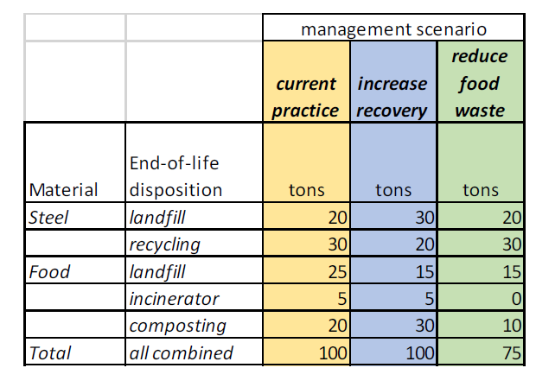
Basic operation
You have to start with solid waste data
The calculator works it backwards through the life cycle and changes it into life cycle impacts
Notes:
Basically the way it works is you have to input a description of your solid waste in terms of tons. Here’s an example, where there’s some steel and some food waste. Some of the steel is recycled, and some of the food is composted.
WIC takes these tons and works them backwards through the materials life cycle to get a total impact associated with the waste.

Slide 25
You play around with managing tons to see how to lower impacts
Notes:
However, just one total isn’t very interesting. You can put in other scenarios for dealing with waste and see if it lowers the impact. Here’s one scenario where recovery is increased. And other where food waste is just prevented.
If you look over at the chart, you see the lowest bar is for the last scenario.
In the Waste Impact Calculator, lower impacts are always better. So you are looking for the ways to make your bars smaller.

Slide 26
Let’s try it!

